Slide 1


Exposure Java 2013
APCS Edition
Chapter 15 Slides
Program Design
PowerPoint Presentation
created by:
Mr. John L. M. Schram
and Mr. Leon Schram
Authors of Exposure Java

Slide 2
Section 15.1
Introduction

Slide 3
Introduction
Correct program design makes the complexity of today's program requirements possible.
The average student thinks that any program over 1000 lines in length is a large program.
Yet a typical video game
created in the late 1990s
had programs that exceed
500,000 lines of programming.
These video games are quite small compared to application programs like CAD and many other popular application programs.

Slide 4
Pre-OOP Program Design
"The 5 Stages of Program Development"
Step # | Step Mission
1 | Understand the Problem
2 | Develop an Algorithm
3 | Code the Algorithm
4 | Test and Debug the Program
5 | Update and Enhancement

Slide 5
OOP Program Design
Step # | Step Mission
1 | Understand the Problem Description
2 | Class Design
3 | Method Design
4 | Class Interaction
Now that OOP has become the thing-to-do, the program design steps need to be adjusted somewhat. This is not to say that the previous five steps are meaningless. Far from it. Even with OOP when you write an individual method, you will probably go through these exact five steps. However, this chapter is not titled Method Design, but rather Program Design.

Slide 6

Fundamental Program Design
Write your program in a clear, consistent style.
Use meaningful, self-documenting identifiers.
Do not place all your code in the main method.
Create modules for recognizable tasks.
Place common purpose modules in a class.

Slide 7
APCS Program Design
Comprehend the design of a provided program
Understand a problem description, purpose and goals
Apply data abstraction and encapsulation
Understand class specifications
Understand "is-a" class relationships
Understand "has-a" class relationships
Understand and implement a given class hierarchy
Identify and use existing class libraries
Identify reusable code from existing code
Design classes
Know implementation techniques

Slide 8
AP Exam Alert
You can expect AP Computer Science Examination questions on the multiple choice segment and the free response segment about program design.

Slide 9
Section 15.2
The Design
Compromise
Triangle

Slide 10
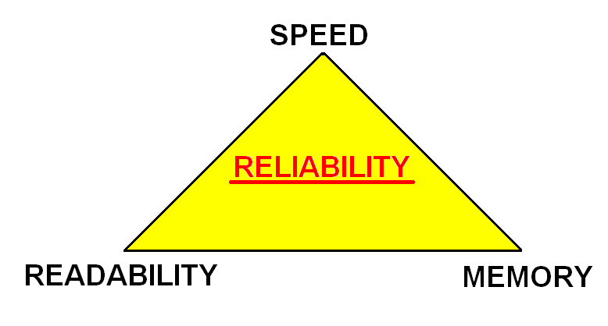
The Design Compromise Triangle
In the old days, readability was sacrificed for memory.

Slide 11
The Design Compromise Triangle
Now, memory is sacrificed for readability and speed.

Slide 12
The Design Compromise Triangle
The one thing that can NEVER be compromised is Reliability!

Slide 13

Computer Error?
The statement
"Computer Error"
really is a
"human error"
in the creation of
a computer program.

Slide 14
Section 15.3
Understand the
Problem Description

Slide 15
Chess Analogy - 1
Consider Alex.
Alex is the world's
greatest chess player.
Alex is very dissatisfied
with current chess simulation
software and has been quoted as saying:
"I get a better game of chess from the toaster!"

Slide 16
Chess Analogy - 2
Consider Philip.
Philip is the world's
greatest programmer.
Philip is contacted by Alex.
Alex wants to hire him to
write a more challenging
chess program.
Philip has never played chess.
Question: Can Philip write this program?

Slide 17
Chess Analogy - 3
Answer:
NO!
Philip cannot write a chess program
until he learns how to play chess.

Slide 18

Chess Analogy - 4
Possible Solution:
Consider Brenda.
Brenda has been
programming and
playing chess for
a few years.
She is the perfect intermediary for
Alex and Philip.

Slide 19
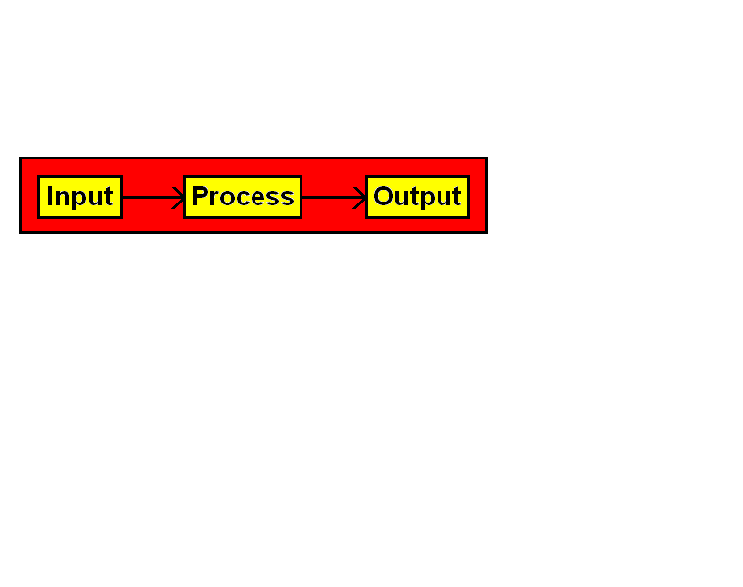
Program Specifications
All program specifications can
be simplified to this statement:

Slide 20
Program Specifications Note
Program specifications follow a
top-down approach.
This means that specifications are delivered from general to specific.
Top
Down

Slide 21
Section 15.4
Class Design

Slide 22
How do you design a class?
A class is like a toolkit.
A good toolkit contains several tools that are similar in function. A saw and a paint brush should be in different toolkits.

Slide 23
private vs. public
You also need to decide which members will be public and which will be private.
Example #1
Example #2
Example #3
private all data
public all methods
private all data helper methods
public most methods
private most data
public all methods final data

Slide 24
AP Exam Alert
For the specific purpose of writing solutions to free response class design questions, declare data attributes private and action methods public.
Keep in mind that there are situations where it is appropriate for attributes to be public and methods to be private.

Slide 25
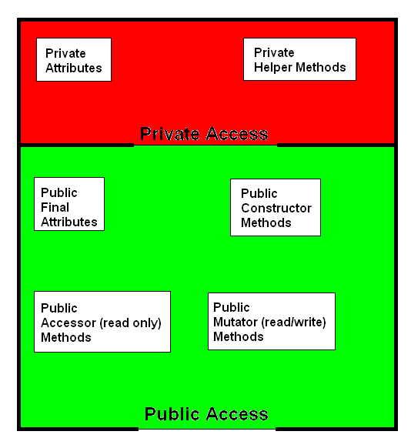
Example #4
Math.PI
& Math.E
are
examples
of this.

Slide 26
Constructor Methods
All classes need to be designed
with one or more constructors.
Constructors are automatically called
during the instantiation of an object.
At a minimum, constructors need to provide
initial values for the data attributes of a class.
All constructors are declared public and they
are neither void methods nor return methods.
Many classes require multiple "overloaded" constructors to allow object flexibility
during the instantiation of a new object.

Slide 27

Accessor Methods
Methods are also called:
actions
operations
procedures
functions
subroutines
Accessor methods are also called: get methods.
Accessor methods are read-only methods.
It is not required, but most accessor methods are return methods, which provide information about the private data information of an object.

Slide 28
Mutator Methods
Methods are also called:
actions
operations
procedures
functions
subroutines
Mutator methods are also called: set methods.
Mutator methods are read/write methods.
Program design requires careful scrutiny of the mutator methods. Mutator methods not only implement some algorithm to process data, but they also alter the data. Carelessly designed mutator methods can do serious, unwanted, damage to object data.

Slide 29
Section 15.5
Method Design

Slide 30
Preconditions & Postconditions
Methods have preconditions and they have postconditions.
It is the job of the method to implement an algorithm that takes the precondition to the required postcondition.
A precondition is what you can assume is true before a method begins.
A postcondition specifies what will be true at the end of the method -- provided the precondition was true.

Slide 31
Pre & Postcondition Examples
// precondition: list is a non-empty ArrayList object
// of Integer elements
// postcondition: The Integer values in list are sorted
// in ascending order
public static void sortList (ArrayList list)
// preconditions: list is a non-empty ArrayList object
// of Integer elements
// The Integer elements in list are
// randomly ordered
// postcondition: returns the median value of list
public static double getMedian (ArrayList list)

Slide 32


Method Writing Hint
If you cannot implement
the code in the method
body, take out a piece of
paper and write down the
actual steps necessary to
solve the problem.
You cannot write the steps in a program language, when you cannot write the steps in English.

Slide 33
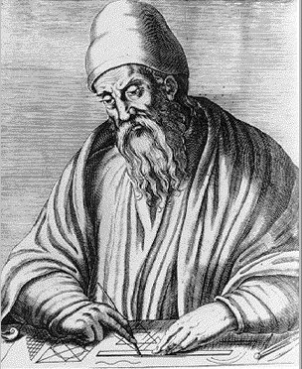
Euclid's GCF Algorithm
Step | Process | Computation
1 | Divide num 1 by num 2 | 120 / 108 = 1
2 | Determine remainder | 120 - (1 * 108) = 12
3 | Check if remainder equals zero | 12 is not 0
4 | Numerator (num1) becomes Denominator | Num = 108
5 | Denominator (num2) becomes remainder | Den = 12
6 | Divide num1 by num2 | 108 / 12 = 9
7 | Determine remainder | 108 - (9 * 12) = 0
8 | Check if remainder equals zero | 0 = 0
9 | If remainder equals 0 then the GCF is the denominator | GCF is 12

Slide 34
GCF in Java Code
public int getGCF (int n1, int n2)
{
int temp = 0;
int rem = 0;
do
{
rem = n1 % n2;
if (rem == 0)
temp = n2;
else
{
n1 = n2;
n2 = rem;
}
}
while (rem != 0);
return temp;
}

Slide 35
Section 15.6
Class Interaction

Slide 36
Program Design Reality
It is easy to explain program design as a clean sequence of steps that steadily develop the finished program.
In reality all the aspects of the program requirements are rarely known at the start of program development and additions, deletions, alterations are common.

Slide 37
Class Interaction
There are three ways that classes can interact:
Utility
Inheritance
Composition

Slide 38
Class Interaction Utility
Utility classes are usually have static methods like the Math class.
These classes have useful tools for writing programs.

Slide 39
Class Interaction Inheritance
It is not always necessary to start from scratch.
Do not reinvent the wheel,
but use what is already available.
Extend the existing class and then develop additional methods or redefine existing methods.
Inheritance is called an "is-a" relationship.
A classic example of using inheritance is available in the GridWorld Case Study.

Slide 40
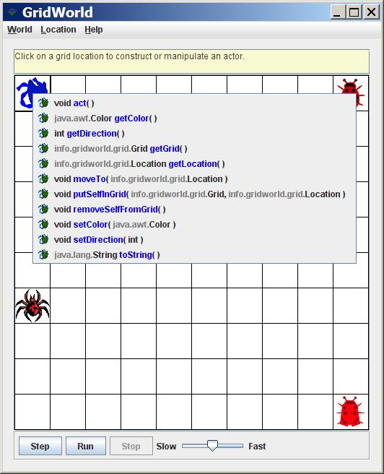
Inheritance Demonstrated with GridWorld-1
In GridWorld, if you click on an Actor object, you will see all of the methods available from the Actor class.

Slide 41
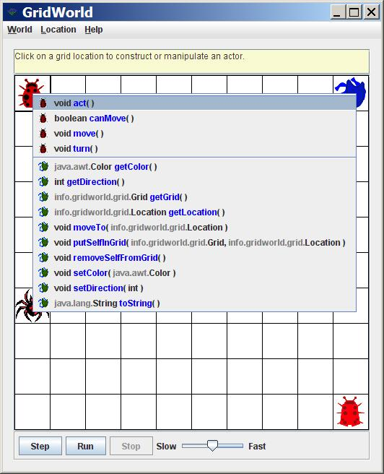
Inheritance Demonstrated with GridWorld-2
If you click on a Bug object, you will see all of the Bug methods.
You will also see all of the methods Bug inherits from Actor.

Slide 42
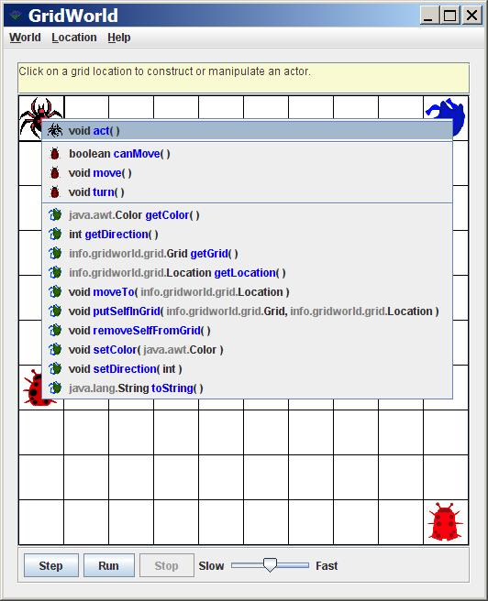
Inheritance Demonstrated with GridWorld-3
Here, Multi-Level Inheritance is demonstrated.
An OctagonBug inherits from a Bug, and a Bug inherits from an Actor.

Slide 43
Class Interaction Composition
Utility is great and inheritance is very nice, but the truth is that your program will probably rely more on composition than any other type of class interaction.
Composition is the "has-a" relationship.
With composition, programs become much more manageable.

Slide 44
Unit Classes
A unit class is a class that contains the attributes and process method of a single practical unit.
Classic examples of unit classes are:
Student - Patient - Employee - Product

Slide 45
Managing Problems and Programs
The secret of managing complex problems, or programs, is to divide the problem into smaller manageable chunks.
In the case of Object Oriented Programming this starts by selecting appropriate classes.
A good starting point is to select the "unit" classes for your program.

Slide 46
Section 15.7
Testing and
Debugging
the Program

Slide 47
Review of Types of Errors
There are 3 main types of errors with computer programs:
Syntax/Compile Errors
Runtime Errors
Logic Errors
system,out.pwintlm(Hello"):
int a = 1;
int b = 0;
int c = a / b;
int[] list = new int [10];
System.out.println(list[20]);
int sum = 4 * 6;
System.out.println("4 + 6 = " + sum);

Slide 48
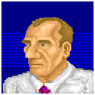
Don’t Be This Type of Student!
Student: Can you help me?
Teacher: What do you need?
Student: I have a problem.
Teacher: What type of problem do you have?
Student: My computer has a problem.
Teacher: What is wrong with your computer?
Student: It does not work.
Teacher: What is it that does not work?
Student: My program does not work.
Teacher: What is working or not working
with your program?
Student: I don’t know. It does not work.
Teacher: You must know what is wrong,
even if you cannot fix the problem.
Student: If I knew what was wrong,
I would not ask for help.

Slide 49
Compile/Syntax Error Facts
• The compiler will catch all syntax errors.
• The error message is not always an
accurate description of the actual syntax
error.
• The compiler does not necessarily stop
at the correct error location.
The error indicator stops either on or
before the actual error location.

Slide 50
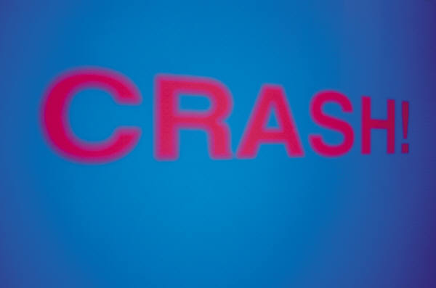
Runtime Error Definition
A runtime error or execution error is an error that interrupts program execution.
This is more popularly known as the program "crashes".

Slide 51
Exceptions
Java does not use the term runtime errors or execution errors.
Java has exceptions and all runtime error messages include the word exception and the type of exception that has been detected.
There are five common runtime exceptions, which require closer inspection.

Slide 52
ArithmeticException
An ArithmeticException occurs an attempt is made to perform an illegal arithmetic operation.
One example occurs when the
program tries to divide by zero.
This error does not occur with
all illegal arithmetic operations.
For instance the statement
System.out.print(Math.sqrt(-10));
does not display an exception message,
but displays NaN, which means “Not a Number”.
1 ÷ 0
√
-10

Slide 53
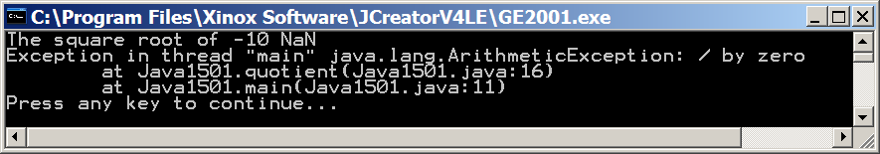
// Java1501.java
// This program demonstrates an Arithmetic Exception.
// It also shows that taking the square root of a negative number
// does NOT cause an arithmetic exception.
// Instead, it displays NaN which means "Not a Number".
public class Java1501
{
public static void main(String[] args)
{
System.out.println("The square root of -10 " + Math.sqrt(-10));
System.out.println("1 divided by 0 equals " + quotient(1,0));
}
public static int quotient(int numerator, int denominator)
{
return numerator / denominator;
}
}

Slide 54
IllegalArgumentException
An IllegalArgumentException occurs when an illegal argument is used for a method call.
When a method is created the programmer can choose to throw this exception if inappropriate parameter data is passed to the method.

Slide 55
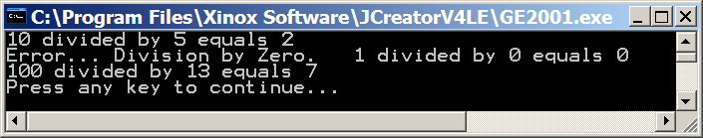
// Java1502.java
// This program tries to protect against division by zero.
// The result is not exactly what we want.
public class Java1502
{
public static void main(String[] args)
{
System.out.println("10 divided by 5 equals " + quotient(10,5));
System.out.println("1 divided by 0 equals " + quotient(1,0));
System.out.println("100 divided by 13 equals " + quotient(100,13));
}
public static int quotient(int numerator, int denominator)
{
if (denominator == 0)
{
System.out.print("Error... Division by Zero. ");
return 0; // Will not compile without this return statement
}
else
return numerator / denominator;
}
}

Slide 56
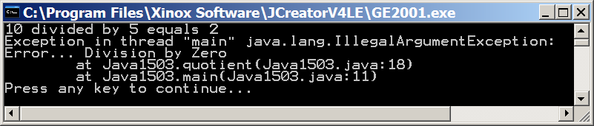
// Java1503.java
// This program demonstrates a user-created Illegal Argument Exception.
public class Java1503
{
public static void main(String[] args)
{
System.out.println("10 divided by 5 equals " + quotient(10,5));
System.out.println("1 divided by 0 equals " + quotient(1,0));
System.out.println("100 divided by 13 equals " + quotient(100,13));
}
public static int quotient(int numerator, int denominator)
{
if (denominator == 0)
throw new IllegalArgumentException("\nError... Division by Zero");
else
return numerator / denominator;
}
}

Slide 57
ClassCastException
A ClassCastException occurs when an attempt is made to cast a variable to a non-matching class.

Slide 58
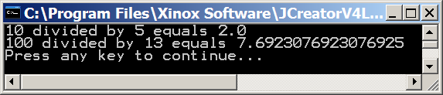
// Java1504.java
// This program reviews "typecasting".
public class Java1504
{
public static void main(String[] args)
{
System.out.println("10 divided by 5 equals " + quotient(10,5));
System.out.println("100 divided by 13 equals " + quotient(100,13));
}
public static double quotient(int numerator, int denominator)
{
return (double) numerator / denominator;
}
}

Slide 59
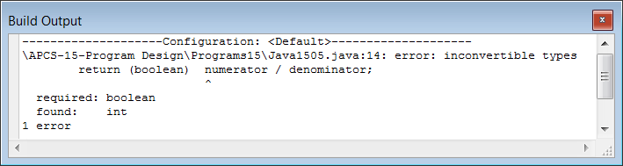
// Java1505.java
// This program shows that typecasting is not always possible.
public class Java1505
{
public static void main(String[] args)
{
System.out.println("10 divided by 5 equals " + quotient(10,5));
System.out.println("100 divided by 13 equals " + quotient(100,13));
}
public static boolean quotient(int numerator, int denominator)
{
return (boolean) numerator / denominator;
}
}

Slide 60
// This Animal class and its subclasses are used in the next couple programs.
class Animal
{
public Animal() { System.out.println("Animal constructor called"); }
}
class Cat extends Animal
{
protected String catType;
public Cat(String ct) { catType = ct; }
public String getType() { return catType; }
}
class Bird extends Animal
{
protected String birdType;
public Bird(String bt) { birdType = bt; }
public String getType() { return birdType; }
}
class Fish extends Animal
{
protected String fishType;
public Fish(String ft) { fishType = ft; }
public String getType() { return fishType; }
}

Slide 61
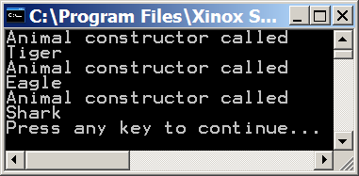
// Java1506.java
// This program demonstrates "class casting".
public class Java1506
{
public static void main(String args[])
{
Animal tiger = new Cat("Tiger");
System.out.println(((Cat) tiger).getType());
Animal eagle = new Bird("Eagle");
System.out.println(((Bird) eagle).getType());
Animal shark = new Fish("Shark");
System.out.println(((Fish) shark).getType());
}
}

Slide 62
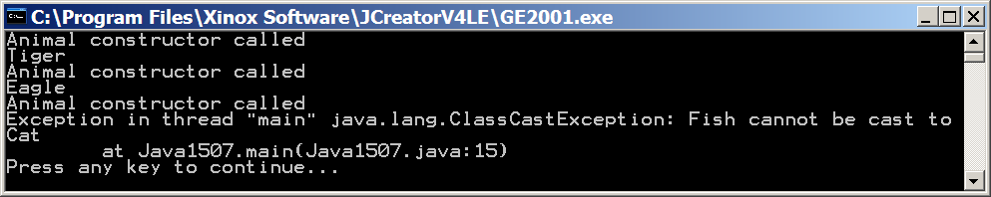
// Java1507.java
// This program causes a "ClassCastException"
// when a Fish object is cast as a Cat.
public class Java1507
{
public static void main(String args[])
{
Animal tiger = new Cat("Tiger");
System.out.println(((Cat)tiger).getType());
Animal eagle = new Bird("Eagle");
System.out.println(((Bird)eagle).getType());
Animal shark = new Fish ("Shark");
System.out.println(((Cat) shark).getType());
}
}

Slide 63
ArrayIndexOutofBoundsException
An ArrayIndexOutOfBoundsException occurs when an attempt is made to access an array with an index outside the range of the array's indexes.
This error is quite common, because students frequently forget that the number of elements in an array is not the same as the largest index in an array.

Slide 64
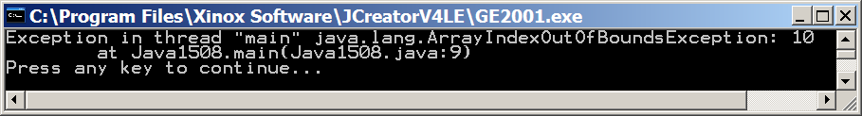
// Java1508.java
// This program reviews the ArrayIndexOutOfBoundsException
public class Java1508
{
public static void main(String args[])
{
int[] list = new int [10];
System.out.println(list[10]);
}
}

Slide 65

NullPointerException
A NullPointerException occurs when an attempt is made to reference an object using an object variable that is null.
In a correct situation an object is a memory reference to a location where the object's attribute values can be accessed. | If the object's reference is a null value then any attempt to access some attribute field will fail.
student1
@dff6ccd
dff6ccd
John Smith
student2
@0000000
Pointer Pointee Null Pointer No Pointee

Slide 66
// This Student class is used in the next few programs.
class Student
{
private String name;
private int age;
private double gpa;
public Student (String n, int a, double g)
{
name = n; age = a; gpa = g;
}
public String getName() { return name; }
public int getAge() { return age; }
public double getGPA() { return gpa; }
}

Slide 67
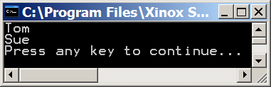
// Java1509.java
// This program demonstrates 2 student objects
// properly being constructed and displayed.
public class Java1509
{
public static void main(String[] args)
{
Student stu1 = new Student("Tom",17,3.99);
Student stu2 = new Student("Sue",18,2.57);
System.out.println(stu1.getName());
System.out.println(stu2.getName());
}
}

Slide 68
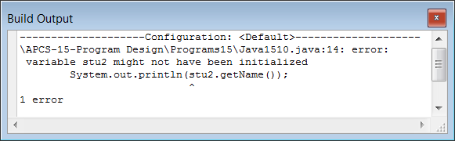
// Java1510.java
// In this program the second student is not initialized.
// This does NOT cause a NullPointerExceptionm because the
// program does not compile.
public class Java1510
{
public static void main(String[] args)
{
Student stu1 = new Student("Tom",17,3.99);
Student stu2;
System.out.println(stu1.getName());
System.out.println(stu2.getName());
}
}

Slide 69
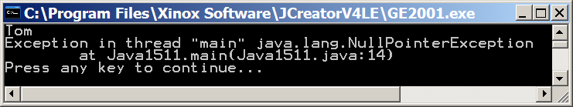
// Java1511.java
// In this program the second student is initialized to null.
// Since the object is initialized, the program compiles.
// When the program tries to display the name of an object
// which is null, the program has a NullPointerException.
public class Java1511
{
public static void main(String[] args)
{
Student stu1 = new Student("Tom",17,3.99);
Student stu2 = null;
System.out.println(stu1.getName());
System.out.println(stu2.getName());
}
}

Slide 70
"There are no pointers in Java."
You will hear several people say this about Java.
Technically, this statement is completely true!
Java has no pointers, but it does have references.
The difference between the two is that a
pointer is declared to store the memory
address of a particular data type.
A reference simply stores a memory address with no knowledge of what it is pointing to.
NOTE: Java still manages to have NullPointerExceptions as appose to NullReferenceExceptions.

Slide 71
AP Exam Alert
Students are expected to understand the common runtime errors generated by Java, which include:
NullPointerException
IllegalArgumentException
ArrayIndexOutOfBoundsException
ArithmeticException
ClassCastException
It is not required that students know how to create exception handling code with throw, try & catch.

Slide 72
Logic Error Definition
A logic error occurs when a program's output is not logically correct, even though the program compiles, and the program executes without crashing.
The careful use of well-chosen test data catches logic errors.

Slide 73
Program Testing Steps
1. Test the program first with easy to tell test data.
For example, a program that averages student's
grades should start with all grades of 100.
Your average has to be 100.
2. Test the program with a set of test data for which
the correct output is known.
If you average a set of peculiar numbers,
check the answer first on a calculator.
3. Test the program with a wide variety of data, for
every known path that is possible in the program.
4. Test the program carefully with test data at
borderline cases.

Slide 74
Types of Test Data
Minimal Test Data is a set of data that checks every possible path in a program, at least once.
Thorough Test Data is a set of data that checks every possible path in a program, and checks the border cases as well, at least once.

Slide 75
Carburetor Logic
Mechanic: What is wrong with your car?
Customer: My car does not start.
Mechanic: Let me check.
Wow, your carburetor is gone.
No wonder your car does not start.
What happened to your carburetor?
Customer: I removed my carburetor.
Mechanic: Why?
Customer: My car would not start.
Mechanic: Your car cannot start without a carburetor.
Customer: My car did not start with the carburetor,
so I removed it.

Slide 76
The Hidden Logic Error
Students often think that a computer with a totally black screen has “crashed.”
Nothing is showing and nothing is happening.
Frequently, the program is stuck in an infinite loop without a means to exit.
This is not a runtime error.
The computer is busily
doing what it is told.
This is a logic error.

Slide 77
Section 15.8
Information
Hiding

Slide 78
Information Hiding
Information Hiding is a computer science tool that involves using program features without the knowledge of how the program features are implemented.
Example:
You do not need to know how to build a car in order to drive one.

Slide 79
OK, I put the key in the ignition and turn the key. This will complete an electronic circuit and activate the starter motor. As the starter motor turns the engine over, the following process brings the car in motion. Fuel is pumped from the tank to the fuel injectors. The fuel injectors convert the liquid gas to a fine spray and inject this spray inside the chambers of each cylinder. The turning of the engine moves the pistons upward inside the chambers and it compresses the gas into a tight space. With perfect timing the rotor, inside the distributor, completes an electric circuit that sends an electric pulse to the appropriate cylinder. The electric pulse is passed through a spark plug that protrudes inside the cylinder and a small spark is emitted in the chamber. The compressed gas is ignited by the spark and explodes. The explosion causes instant expansion and the piston is driven downward in the cylinder. The piston head is connected to a piston rod, which moves up and down. The up and down motion of the piston rod from the repeated explosions is converted to a circular motion. This circular motion is than transferred to the crankshaft. The crankshaft continues the energy path to the transmission. The transmission then selects the appropriate gear for the car movement. From the transmission the turning force goes by drive shaft and various universal joints to the differential. The differential distributes the turning force to the wheels and the car starts to move.

Slide 80
Reasons for Information Hiding
• There can be valid economic reasons.
• Implementation details may be too
complex and too difficult to understand
• It allows focus on new and different
topics without concern about prior details.

Slide 81


Section 15.9
The Tetris Game
Program Design

Slide 82
Program Design - Step 1 Understand the Problem
The game window is 300 pixels wide and 500 pixels high.
There will be seven different Tetris pieces.
Each new piece will be displayed in a separate 100 X 100
pixel window.
Pieces move automatically downward.
Players can move pieces left, right, and rotate.
Players can also "drop" a piece immediately to its final
position.
Left/right arrow keys will control pieces left and right.
Up arrow key will rotate pieces.
Down arrow drops piece immediately.
And many more program specifications.
Make sure you have the exact program specifications!

Slide 83
Program Design - Step 2 Select Classes
Creation of the seven Tetris pieces
Display the game layout where the pieces move
Operations to move the pieces downward and rotate
the pieces
Display of the next piece coming down
Mechanism to check if piece fits correctly
Mechanism to see if a solid row needs to be removed
Compute and display player score
Detect keyboard interaction for piece movement and
rotation
Check if game is over
Control piece movement speed

Slide 84
Program Design - Step 2 Select Classes
Pieces Class Responsibilities
Store seven different pieces. Randomly select the next piece. Move the piece downward. Rotate the piece
GameWindow class Responsibilities
Store piece location for dropped pieces. Store location of moving piece. Display dropped pieces. Display moving piece.
ProperFit Class Responsibilities
Check movement during downward fall. Check if piece can rotate. Check fit in final position. Check for complete rows.
Control Class Responsibilities
Get game player input. Get next piece ready. Remove completed rows. Update score. Determine finished game. Provide instructions.
Player Class Responsibilities
Get player keyboard input for: Start of game. Left/right movements. Rotating piece. Rapid vertical drop. Game instructions.

Slide 85
Program Design - Step 3 Class Interaction
Now comes the tricky and very significant stage in program development.
At this point our Tetris game has five classes and these five classes may appear in separate containers with methods to process data.
However, the classes need to interact with each other in order for the program to work.

Slide 86
Design Group Discussion
The different classes and their methods will need to seriously interact with each other.
This is an opportunity for you and some other students to work in small teams and examine the suggested classes and methods.
Make a list of classes and methods and decide what interaction is necessary and how it should be implemented.

